Slide 1
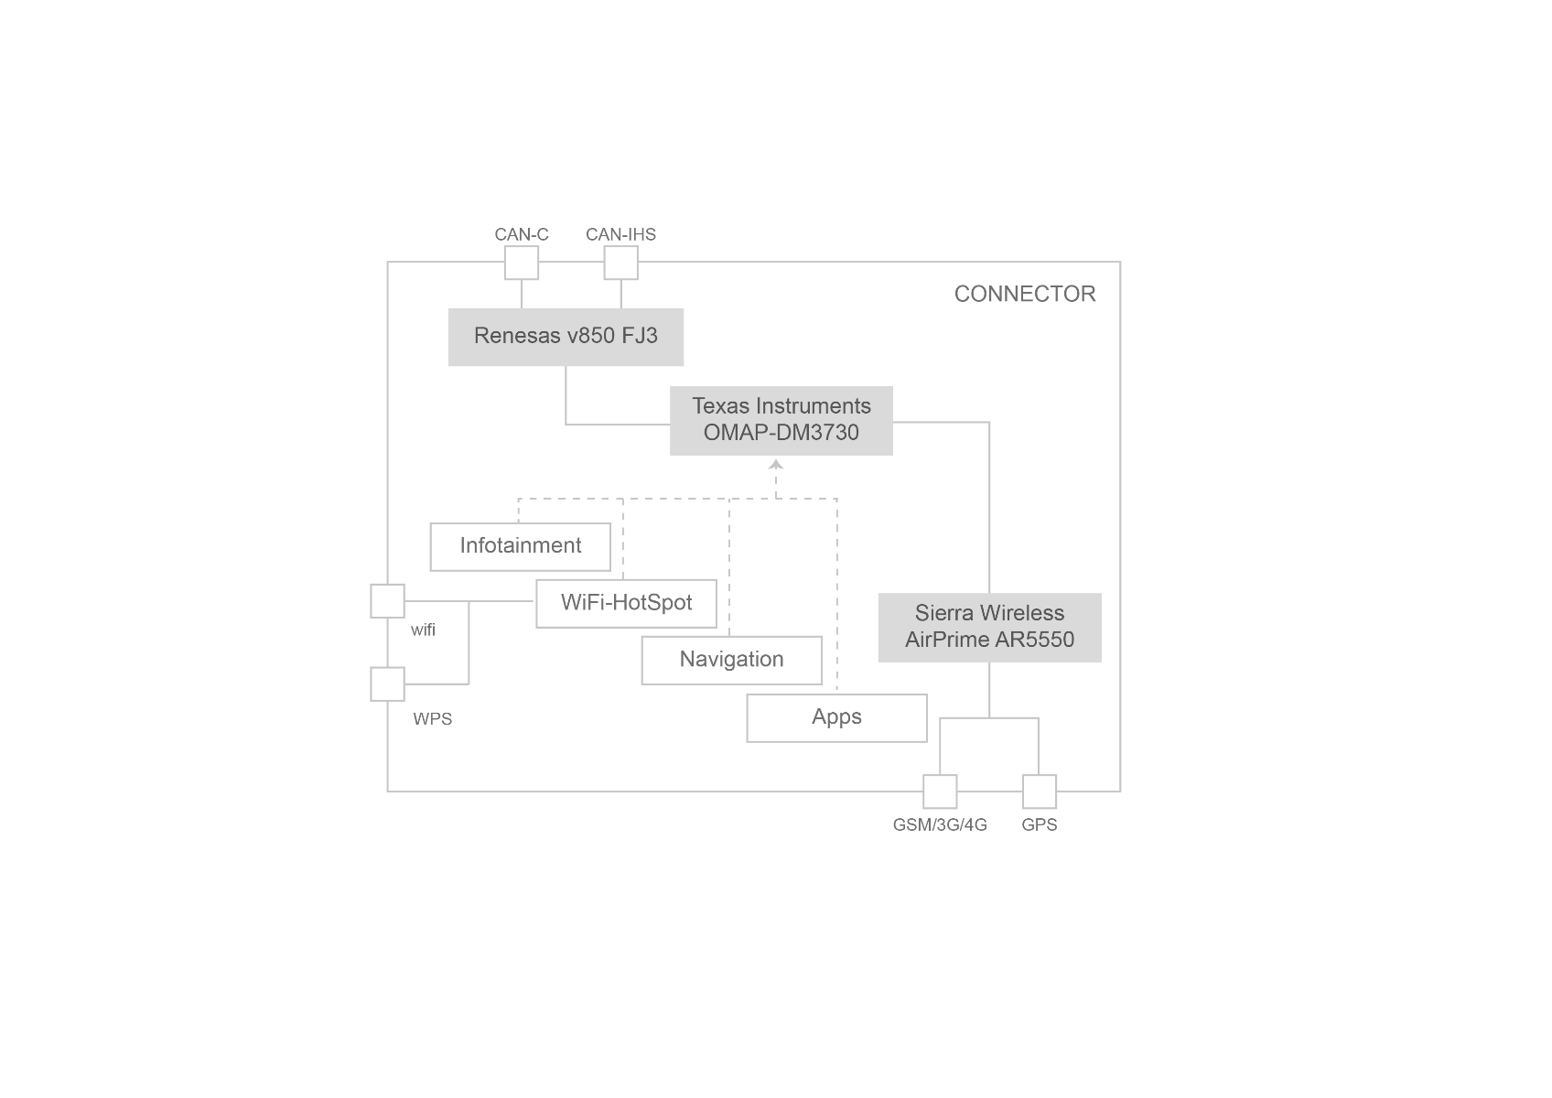
Expleo Ireland Case Study – Serenity/Selenide Automation Framework
Objective
Challenges
Creation of a new Test Automation framework on a greenfield client site, targeting a web application for desktops and browsers that is being built using a DevOps Delivery model
The framework built had to prioritise ease-of-use, scalability, integration with pipeline tooling, long-term viability of the tools and framework, and collaboration with Development, Test, and Business Analysis
Testing required for API/Mobile Web/Desktop UI/DB
Quickly build up a new framework from scratch with open-source tooling
The solution needed to integrate with an Azure DevOps pipeline and provide fast results despite targeting a wide range of desktop-browser and device-browser combinations
Benefits
The use of a BDD layer ensures maximum collaboration between various stakeholders, and Serenity aids this by providing superior reporting to that provided by Cucumber. Serenity also provides built-in support for REST API testing
The use of Selenide as a wrapper for Selenium provides for a simpler interaction with Web UI elements, by using a simpler syntax, and automatically handing synchronisation and WebDriver compatibility issues
The use of MyBatis to handle SQL queries provides for more robust query handling – MyBatis handles database connections, as well as providing Java methods to represent all of the database tables
Project Lombok generates boilerplate code automatically
Overall delivery of new tests is much faster than with a typical solution
Solution
Following collaborative discussions with stakeholders, Expleo advised that a Serenity BDD-Selenide framework was assessed to be the most practical framework for collaboration, taking into consideration the needs of Business Analysis, Development, and Test. This was achieved using open-source tooling (built on a Java framework)
Several innovative tools were chosen to ensure fast, stable delivery, with wrappers for traditional Automation framework tools such as Cucumber and Rest Assured (wrapped by Serenity), Selenium (wrapped by Selenide), and Oracle SQL (wrapped by MyBatis)

Slide 2





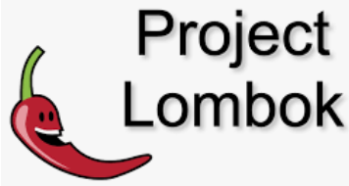











Expleo Ireland Case Study – Serenity/Selenide Automation Framework
INNOVATIONS
COMPONENT | TYPICAL IMPLEMENTATION | INNOVATION | BENEFIT
Automatic Code Generation | None | Lombok | Reduces coding effort by automatically creating typical Java code used in every Java class
Static Code Analysis | None | SonarLint | Automatically analyses automation source code and suggests best-practice optimisations, reducing technical debt
UI Image Comparison | None | Sikuli | Can compare partial screenshots (e.g. of items in product range)
Database Access | JDBC (Java Database Connectivity) | MyBatis | Reduces code needed to query databases and parse results Captures database tables as Java classes
BDD layer | Cucumber | Serenity | Built-in support for REST API testing
Reporting | Cucumber / Allure | ReportPortal | Automatically parses results, grouping failures, to reduce manual effort needed to diagnose issues
UI Interactions | Selenium | Selenide | Reduces configuration required for cross-browser testing, simpler syntax
IDE
REPORTING
TEST FRAMEWORK
FEATURES & TEST STEPS .
TEST STEP IMPLEMENTATION
PAGE OBJECTS
COMMON LIBRARIES
UI
API
MOBILE
DB
TEST FARM TBD
X-BROWSER
MOBILE WEB
PIPELINE

